Slide 1
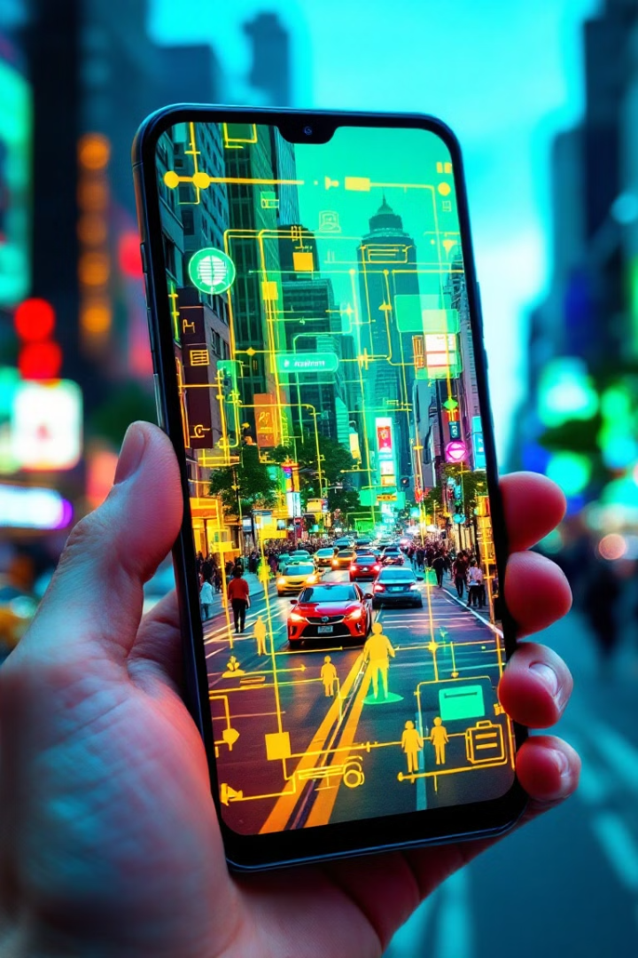
Mobile SAM Reimplementation
This presentation explores the reimplementation of Mobile SAM (Segment Anything Model) for efficient object segmentation on mobile devices.
Disclaimer: slide layout and some images were generated using AI
by Cole Richardson
CR
Notes:
Hello, my name is Cole and this is a presentation for my ECE570 final project focused on reimplementing the Mobile SAM paper from June 2023. SAM stands for Segment Anything Model.

Slide 2
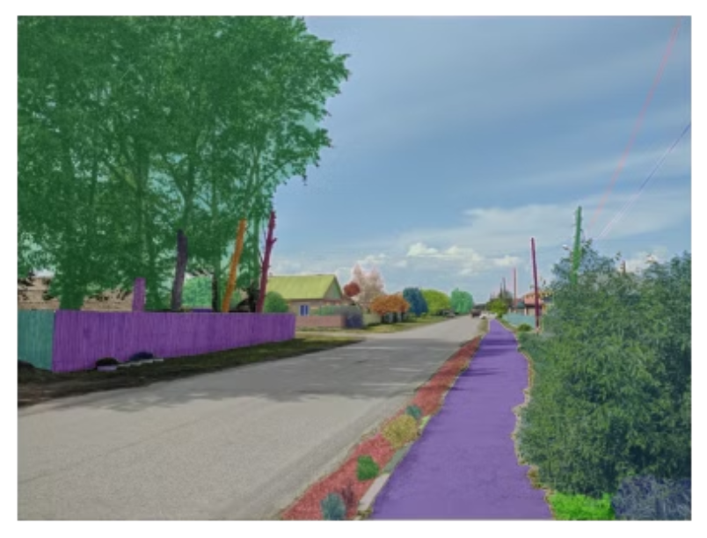
Image Segmentation Task
Image segmentation is the process of identifying and separating objects within an image. It's a fundamental task in computer vision, enabling various applications.
Self-driving cars: Identifying obstacles and pedestrians for safe navigation.
Medical imaging: Analyzing organs and tissues for diagnosis and treatment planning.
Manufacturing Defect Detection
Notes:
Before diving into the details, I want to discuss the task the SAM model was designed for. Image segmentation is a fundamental computer vision task that is similar to object detection. Segmentation focuses on classification at the pixel level by dividing the entire image into regions and assigning classes. Whereas object detection usually focuses on identifying specific objects and their associated bounding boxes. Image segmention is usually more fine-grained than object detection. The image here shows an example output from Meta's Segment Anything Model released in April 2023. The image shows the top few classes based on their area, I'm not sure why the model didn't segment the road as one large class.

Slide 3
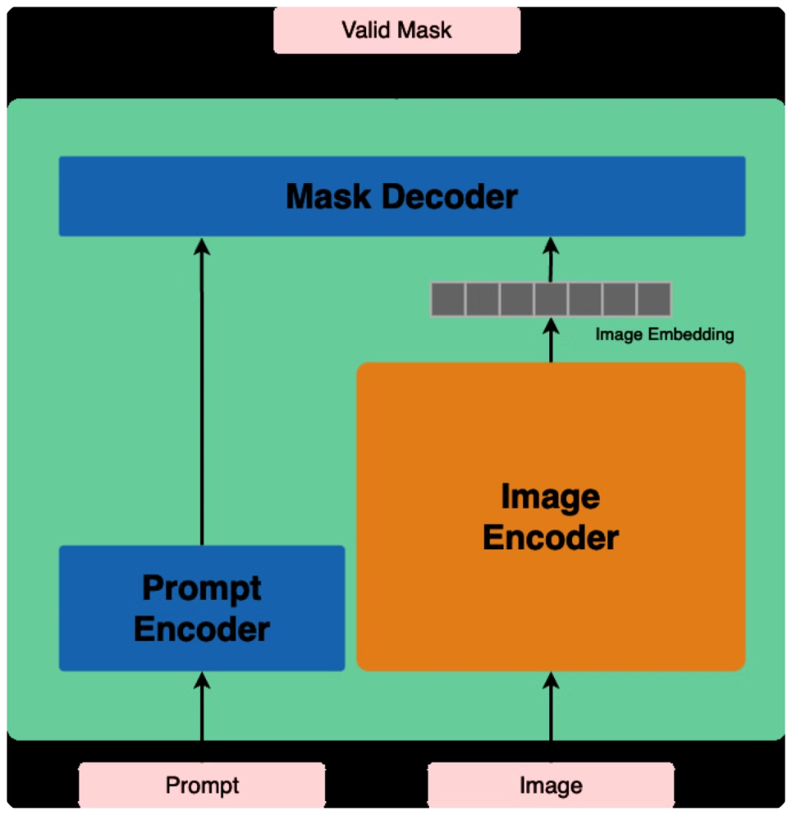
SAM Model Architecture:
The SAM model architecture consists of 3 components:
Prompt Encoder - Inputs from user as points, bounding boxes and even text
Image Encoder - Vision Transformer based, main focus of the project
Mask Decoder - Accepts embeddings from promt and image encoder and outputs multiple segmentation masks.
Notes:
This slide presents a high level overview of the SAM model architecture. The model consists of three main components, the promt encoder which is responsible for encoding user inputs such as points, bounding boxes, other segmentation masks and even text. Next is the image encoder which is the main focus for this project and it uses a vision transformer based model to encode the input images. Finally, the mask decoder accepts embeddings from the other two components and produces multiple output masks.

Slide 4
Knowledge Distillation → Smaller Model
1
Meta SAM Model
2
Student Model
The original SAM model is a powerful foundational model for image segmentation, but it requires significant computational resources (641 M parameters).
Same Prompt Encoder and Mask Decoder + weights
Replaces Image Encoder with Tiny ViT (10 M parameters).
3
Knowledge Distillation
Knowledge distillation is used to transfer the knowledge of the larger SAM model to a smaller, more computationally efficient model.
Image embeddings from larger model image encoder are saved to disk for all input samples as part of pre-training. This is a key step as evaluating the large teacher model is computationally expensive.
MSE Loss is calculated between image embedding from larger model and student model.
Notes:
The high level goal of this project was to take the SAM foundational model released by Meta in 2023 and use it to train a smaller model that can be used on mobile or embedded devices. Meta's SAM model has 641 M parameters which is far too large for inference on current mobile devices. The image encoder is the main focus for creating a smaller model because it alone is 637 M of the total 641 M parameters. The student mobile SAM model shares the exact same architecture as Meta's SAM model and even reuses the pre-trained weights for the prompt encoder and mask decoder but it replaces the image encoder with the Tiny Vision Transformer model so the entire model is only 10 million parameters. To distill the knowledge from the larger model image encoder to the smaller student model image encoder, we start with the larger SAM model and its pre-trained weights. Each image is fed forward through the image encoder and the resulting image embedding is saved to disk. Then the same image is fed into the student model for training and the loss is computed between the image embeddings using MSE.

Slide 5

Dataset: SA1B
1
Segment Anything 1 Billion (SA1B)
11 million images & 1 billion associated segmentation masks. On average 100 masks per image.
2
Custom Pytorch Dataset Implementation
There isn't a Pytorch dataset class for SA1B, so a custom one was developed.
3
Subset of data selected
For training the student model, a subset of 220,000 images were selected.
Notes:
The dataset used for training the student Tiny ViT based model was the SA1B dataset released with Meta's original SAM model. This dataset is very large and consists of 11 million source images and 1 billion associated segmentation masks. I underestimated this portion of the project because there isn't a Pytorch implementation for SA1B dataset so I had to write my own. Because the dataset was so large, only a subset of 220,000 images were used to train the student model.

Slide 6
Training
1
Pre-training: Create teacher Image Embeddings
220,000 images → 36 hours
1.5 TB of data: Original Images + Teacher Embeddings
2
Student Model:
Batch size: 8
Epochs: 2
MSE Loss
A5000 GPU via runpod.io → 12 hours
Notes:
This slide shows an overview of some of the training metrics. As you can see, evaluating the teacher model to generate the image embeddings took a significant amout of time. Had to move away from Google Copilot because it doesn't run well in the background. I ended up renting a GPU from runpod.io for a total of

Slide 7
Evaluation
Metric
Custom Mobile SAM
Mobile SAM
Original SAM
mIoU
0.6284
0.7447
1.0 (truth)
Latency (single prompt point)
0.33 s
N/A
2.15 s
Image Encoder Parameters
6 M
6 M
637 M
Notes:
The slide presents a comparison of different metrics for three different models. The key metrics shown are mean Intersection over Union (mIoU), Latency, and the number of Image Encoder Parameters. Unfortunately, the custom trained mobile SAM has an mIoU less than the model from the paper. There wasn't any training code available with the paper so it's difficult to know why this happened.

Slide 8
Future Considerations
Better training
Interactive Mobile Demo:
Data augmentation: crop, rotate, add noise…
Build a web-browser based implementation where model uses browser GPU API to run Mobile SAM model.
More epochs
SAM 2:
SAM 2 was released by Meta in July 2024. It would be interesting to train the student model using this updated version.
Notes:
This slide shows some potential future considerations for this project. To improve the mIoU, my first step would be to implement some data augmentation during training. Also, one of the original goals I had for this project was to get the trained model running in the browser to provide an interactive demo but I just ran out of time.

Slide 9

Questions and Answers
Are there any questions about the process, the results, or potential future applications?

